Slide 1
Student Performance Prediction
PROJECT PRESENTATION ·
A machine learning system that predicts final marks and shows which factors matter most
STUDENT NAME(S)
ROLL NUMBER
DEPARTMENT
[KRISHANU SINGHA]
[24103460087]
[CSS]
SUBJECT NAME
SUBJECT CODE
[MACHINE LEARNING]
[BCAS7205(P)]
Notes:
Greet the audience and say the project title. Then introduce yourselves with your names and roll numbers. In one line: we built a machine learning system that predicts a student’s final marks and tells us which factors affect those marks the most.

Slide 2
Introduction
Background
1,000
Every semester, colleges collect marks, attendance and assignment records. Most of this data is used only after the results are out.
student records (synthetic)
Project overview
This project uses machine learning to learn how study habits and past performance relate to final marks, and then predicts the marks of a student.
12
factors studied
Why it matters
3
An early prediction lets teachers support at-risk students while there is still time to improve.
models compared
· Student Performance Prediction
2 / 20
Notes:
Explain the background in simple words: colleges have a lot of student data but use it only after the exam. Our project learns the pattern between student habits (study hours, attendance, assignments) and final marks. Mention that the data is created by us (synthetic), as allowed in the project brief. The goal is an early prediction so teachers can help in time.

Slide 3
Problem statement
Marks are known only after the exam, so early help needs a prediction.
Late warning
Many factors
No clear ranking
Weak students are noticed after the result, when it is too late to help.
Attendance, study hours and assignments each show only part of the picture.
It is unclear which factor matters most for a student’s performance.
THE PROBLEM WE SOLVE
Can we predict a student’s final marks from academic and behavioural data, and find the factors that matter most?
· Student Performance Prediction
3 / 20
Notes:
This is the key slide. The real-world issue: a teacher normally knows a student is weak only after the exam result. Three difficulties: the warning is late, many factors act together, and nobody knows which factor matters most. Read the problem statement in the white box slowly. Everything in the project answers this one question.

Slide 4
Objectives
1
Select or create a suitable student performance dataset
2
Clean and preprocess the data
3
Explore the data with charts (EDA)
4
Identify the factors that affect performance
5
Split the data and train several machine learning models
6
Evaluate with MAE, RMSE and R² and visualise the results
EXPECTED OUTCOME
A simple working system that predicts student performance and shows which factors matter most.
· Student Performance Prediction
4 / 20
Notes:
These six objectives are exactly the tasks given in the project brief, so you can say each one is completed. The expected outcome at the bottom is the final deliverable: a working prediction system plus an explanation of the important factors.

Slide 5
Scope of the project
Coverage
Target users
Limitations
Predicts final marks from 0 to 100
Teachers and mentors who want to spot at-risk students early
The dataset is synthetic, not real student data
Predicts a level: At Risk, Average or Good
Academic advisors planning extra support
One snapshot of 1,000 students
Uses 12 academic, behavioural and background factors
Shows relationships, not proof of cause
Students checking how their habits affect marks
Ranks the factors by importance
Runs as a notebook, with no web interface yet
· Student Performance Prediction
5 / 20
Notes:
Coverage is what the system does. Target users are teachers, mentors, advisors and students. Be upfront about the limitations: the data is created by us, so the exact numbers show how the method works and not how real students behave. Also say that a factor being important does not prove that it causes higher marks.

Slide 6
Literature review: existing approaches
Approach | What it does | Limitation
Manual judgement | Teachers watch marks and attendance and apply fixed rules | Subjective and late; ignores how factors combine
Basic statistics | Correlation and simple regression on a few variables | Few variables; misses complex patterns
Data mining (Cortez and Silva, 2008) | Tree, forest, neural network and SVM models predicted school grades | Needs earlier grades; some models are hard to explain
GAP THIS PROJECT ADDRESSES
A simple, explainable pipeline that predicts marks, gives a risk level and ranks the factors behind it.
· Student Performance Prediction
6 / 20
Notes:
Three kinds of existing solutions. First, manual judgement by teachers, which is subjective and late. Second, basic statistics, which cannot handle many factors together. Third, research by Cortez and Silva (2008), who used decision trees, random forest, neural networks and SVM on Portuguese school data and found that earlier grades predict final grades best. Our project keeps things simple and explainable, and also ranks the factors.

Slide 7

Proposed system
INPUT
MODEL
OUTPUT
12 student factors
Linear Regression, trained on 800 students
Marks, level and key factors
Predicts final marks
Shows a performance level
Average error of about 3 marks on students the model has not seen
At Risk, Average or Good, so help can be targeted
Explains the result
Easy to reuse
Ranks the factors that raise or lower marks
Saved model file; the notebook runs in Google Colab with one click
· Student Performance Prediction
7 / 20
Notes:
Our proposed system takes 12 factors about a student as input, passes them to the trained model, and gives three outputs: predicted final marks, a performance level, and a ranking of the important factors. The best model was Linear Regression, and it is wrong by only about 3 marks on average on test students. The trained model is saved as a file, so it can be reused without training again.

Slide 8
Project methodology
Area | What we used
Approach | Step-by-step ML pipeline: data, cleaning, EDA, split, train, evaluate
Language | Python 3
Libraries | scikit-learn (framework), pandas, NumPy, matplotlib, joblib
Algorithms | Linear Regression, Random Forest, Gradient Boosting, plus a Random Forest classifier for levels
Environment | Google Colab or Jupyter Notebook
Data storage | CSV files, so no database is needed
Evaluation | 80/20 train-test split, 5-fold cross-validation, MAE, RMSE and R²
· Student Performance Prediction
8 / 20
Notes:
We wrote everything in Python. pandas and NumPy handle the data, scikit-learn provides the machine learning models, and matplotlib draws the charts. The notebook runs in Google Colab. The data is kept in simple CSV files, so no database is needed. We compared three algorithms and judged them with an 80/20 split, 5-fold cross-validation, and three scores: MAE, RMSE and R squared.

Slide 9

Internal structure: workflow
STEP 1
STEP 2
STEP 3
STEP 4
Dataset
Clean
Explore (EDA)
Split
1,008 raw records, 14 columns
Remove duplicates, fix wrong values, fill gaps
Charts and correlations
800 training and 200 test students
STEP 5
STEP 6
STEP 7
STEP 8
Train
Evaluate
Explain
Predict
Three regression models
MAE, RMSE, R² and cross-validation
Importance scores rank the factors
Saved model gives marks and level
Code: 01_generate_dataset.py creates the data; 02_student_performance.py runs steps 2 to 8.
· Student Performance Prediction
9 / 20
Notes:
Walk through the eight steps from left to right, then the second row. Step 1 is the data. Step 2 cleans it. Step 3 draws charts. Step 4 keeps 20 percent of students hidden for testing. Step 5 trains three models. Step 6 scores them on the hidden students. Step 7 finds which factors matter. Step 8 uses the saved model to predict marks and level for any new student.

Slide 10
Internal structure: dataset design
Academic
Behaviour
Background
Target
How the student performs in class
Daily habits of the student
Personal and family details
What we predict, from 0 to 100
study_hours_per_week
gender
final_marks
previous_marks
sleep_hours
age
assignment_score
screen_time_hours
parent_education
attendance_pct
extra_curricular
participation_score
tutoring
Raw data: 1,008 rows × 14 columns. After cleaning: 1,000 rows × 13 columns (student_id dropped). Stored as CSV files, so no database is needed.
· Student Performance Prediction
10 / 20
Notes:
This is our data design. The dataset has 12 input columns in three groups: academic, behaviour and background, plus one target column, final marks, which is what we predict. Text columns like gender are converted to numbers before training. The data is stored in CSV files, so we did not need a database.

Slide 11
Implementation: major modules
Module | Where | What it does
Data creation | 01_generate_dataset.py | Builds 1,000 students with some dirty data
Cleaning | Script 2, section 2 | Removes duplicates, fixes errors, fills gaps
EDA | Script 2, section 3 | Histogram, heatmap, scatter plots, group bars
Training | Script 2, section 5 | Three models trained on 800 students
Evaluation | Script 2, section 6 | MAE, RMSE, R² on 200 unseen students
Importance | Script 2, section 7 | Shuffle test shows what each column is worth
Level classifier | Script 2, section 8 | Random Forest sorts students into 3 levels
Saving | Script 2, section 9 | Keeps the best model for later use
· Student Performance Prediction
11 / 20
Notes:
The project has eight modules. The first script creates the data. The second script does the rest: cleaning, charts, training, testing, finding important factors, the extra level classifier, and saving the best model. The same code is also available as one Google Colab notebook, with the sections in the same order.

Slide 12
Implementation: training code
# 80% for training, 20% for testing
X_train, X_test, y_train, y_test = train_test_split(
X, y, test_size=0.2, random_state=42)
# scale the data, then fit Linear Regression
model = make_pipeline(StandardScaler(), LinearRegression())
model.fit(X_train, y_train)
# test on students the model has never seen
pred = model.predict(X_test)
print(mean_absolute_error(y_test, pred), r2_score(y_test, pred))
Result: MAE of about 3 marks and R² 0.851 on the 200 test students. The same steps are repeated for Random Forest and Gradient Boosting.
· Student Performance Prediction
12 / 20
Notes:
This is a simplified version of our training code. First the data is split: 80 percent of students teach the model and 20 percent are kept hidden. Then the numbers are scaled to a common range and a Linear Regression model is fitted on the training students. Finally the model predicts the marks of the hidden students and we measure how far off it is. The other two models use exactly the same steps.

Slide 13
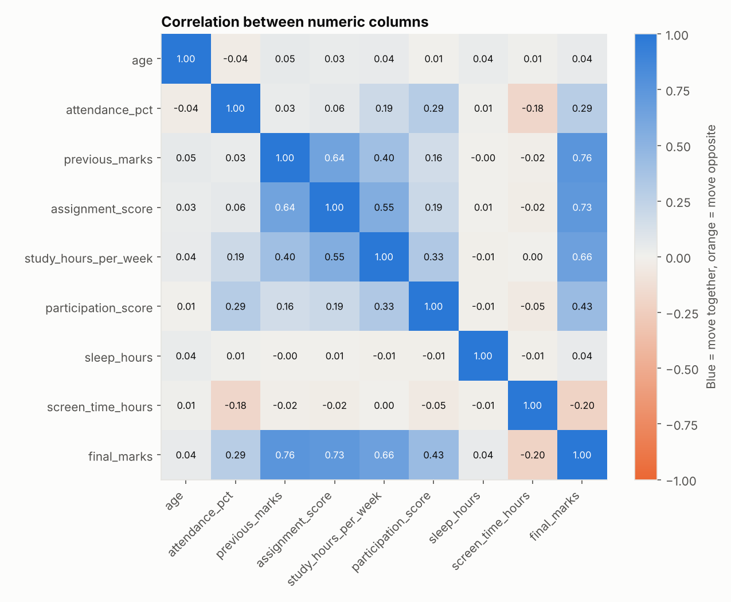
Implementation: exploring the data
Strongest links
Previous marks (r = 0.76), assignment score (0.73) and study hours (0.66) move closely with final marks.
Pulls marks down
Screen time is the only factor with a negative link (r = −0.20).
Little effect
Age, sleep, gender and parent education show almost no link. Tutoring adds about 3 marks (72.8 vs 69.6).
· Student Performance Prediction
13 / 20
Notes:
This heatmap shows how strongly each pair of columns moves together. Blue means they rise together, orange means one rises while the other falls. Look at the last row, final marks: previous marks, assignment score and study hours are the darkest blue, so they are linked most strongly. Screen time is light orange, meaning more screen time goes with lower marks. Remember that a link is not proof of cause.

Slide 14
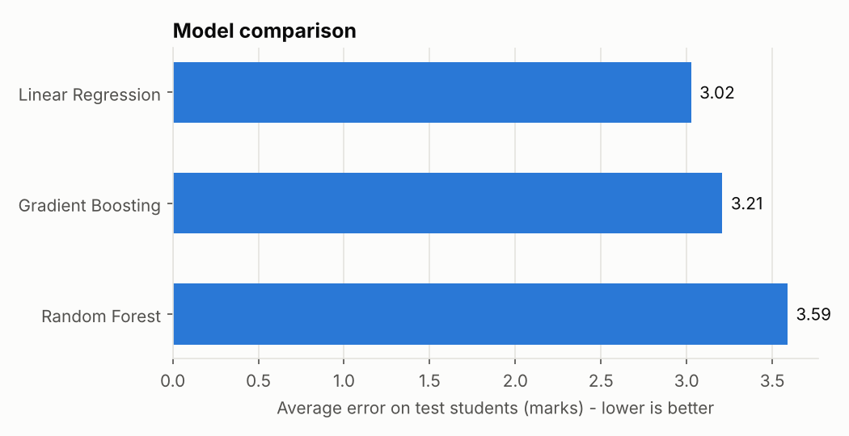
Results: model comparison
About 3 marks
R² = 0.851
7.7 marks
average error of the best model, Linear Regression
about 85% of the variation in marks is explained
error if we simply guessed the class average
Model | MAE | RMSE | R² | CV R²
Linear Regression | 3.025 | 3.705 | 0.851 | 0.866
Gradient Boosting | 3.208 | 3.981 | 0.828 | 0.826
Random Forest | 3.588 | 4.371 | 0.792 | 0.806
· Student Performance Prediction
14 / 20
Notes:
MAE is the average mistake in marks, so lower is better. RMSE is similar but punishes big mistakes more. R squared tells how much of the difference between students the model explains; closer to 1 is better. CV R squared is a repeat check on the training data, and it is close to the test score, so the model is not just memorising. Linear Regression won because our data was built with mostly straight-line relationships. On real data, the tree models might win.

Slide 15
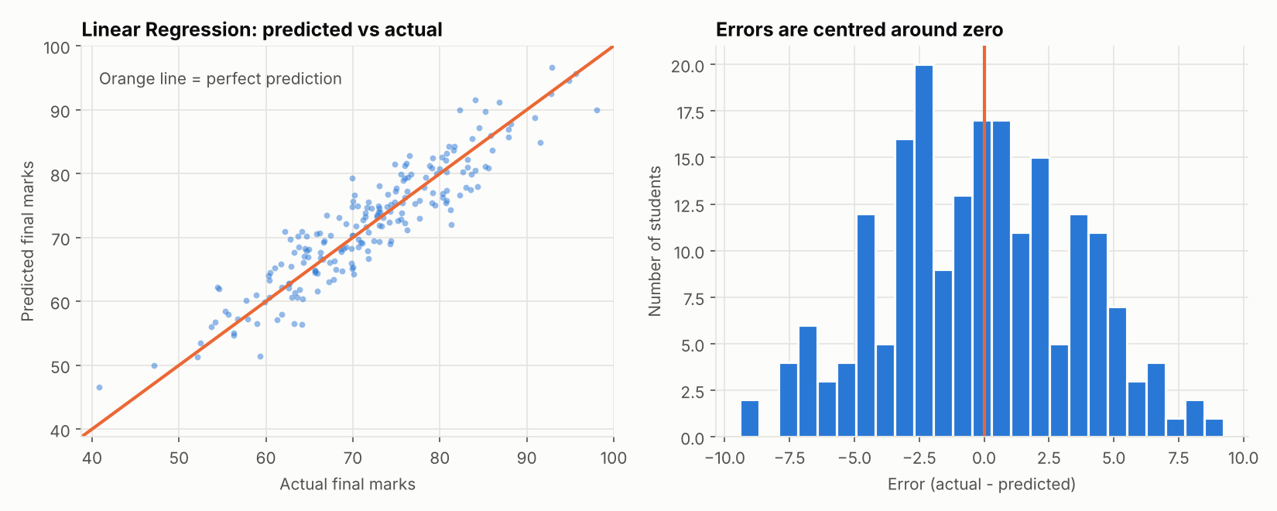
Results: predicted vs actual marks
Dots close to the orange line mean accurate predictions. The errors are centred around zero, so the model does not lean too high or too low.
· Student Performance Prediction
15 / 20
Notes:
Left chart: every dot is one test student. The x position is the real marks and the y position is what the model predicted. If the model were perfect, all dots would sit on the orange line. They are close to it, so the predictions are good. Right chart: the difference between real and predicted marks. Most errors are within 5 marks and the bars are balanced around zero.

Slide 16
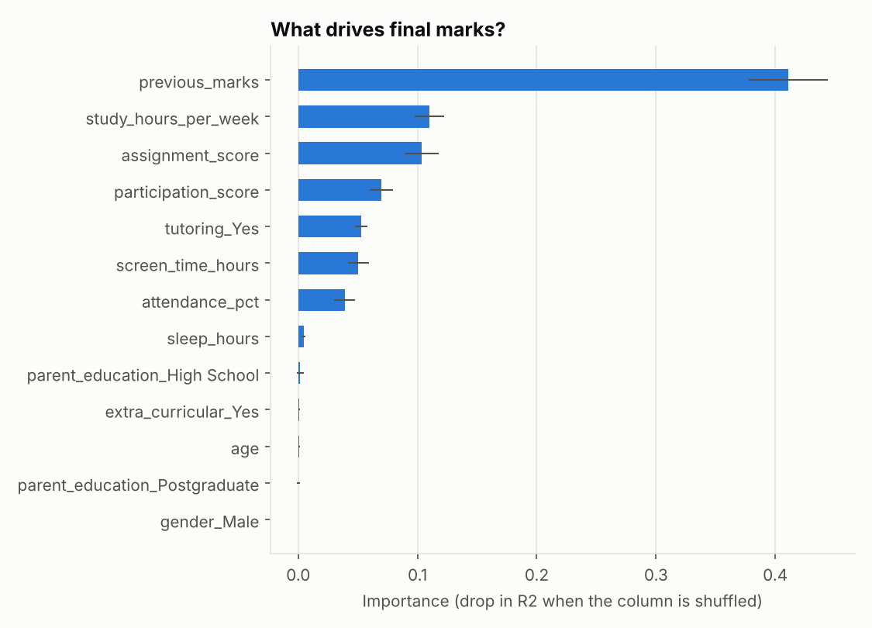
Results: what drives final marks?
Top 3 factors
1. Previous marks (0.41)
2. Study hours (0.11)
3. Assignment score (0.10)
Direction of effect
Raise marks: previous marks, assignments, study hours, participation, attendance, tutoring
Lower marks: screen time
No real effect: gender, age, parent education, extra-curricular
· Student Performance Prediction
16 / 20
Notes:
To find the important factors, we shuffled one column at a time and checked how much the model’s score dropped. A bigger drop means the column matters more. Previous marks matters far more than anything else. Study hours and assignment score come next. Say clearly that these are relationships found in our created data, and that important does not mean it causes the marks.

Slide 17
Testing: sample student cases
Case | Student profile | Predicted | Result
Strong student | 90% attendance, marks 75, assignments 78, 16 study hours, tutoring | 92.8 | Pass: Good
Average student | 78% attendance, marks 57, assignments 58, 12 study hours | 69.9 | Pass: Average
At-risk student | 55% attendance, marks 38, assignments 35, 4 study hours | 43.3 | Pass: At Risk
Extreme case | 95% attendance, marks 85, assignments 88, 20 study hours | 103.9 | Fix needed: cap at 100
78.5%
0.77
0.79
accuracy of the level classifier
macro F1 score across the 3 levels
recall for At Risk students
· Student Performance Prediction
17 / 20
Notes:
We tested the saved model on four made-up students. The strong, average and at-risk students all got the level we expected. The fourth test found a real weakness: for a very strong student, the linear model predicted 103.9, which is above the maximum of 100. The simple fix is to cap predictions between 0 and 100, and we list it under future scope. The level classifier was tested on 200 unseen students: accuracy 78.5 percent, and it catches 79 percent of the at-risk students.

Slide 18

Conclusion
Dataset created: 1,000 students and 12 factors
Data cleaned: duplicates, wrong values and gaps fixed
Data explored: four charts and a correlation heatmap
Key factors found: previous marks, study hours and assignments lead
Three models trained and tested on an 80/20 split
Results evaluated and visualised: error of about 3 marks, R² 0.851
OUTCOME
A simple working system that predicts student marks and shows which factors matter most, as the project asked.
· Student Performance Prediction
18 / 20
Notes:
Go through the six ticks. Each one matches an objective from slide 4, so every objective is addressed. The main result: the best model is wrong by only about 3 marks on average, and previous marks, study hours and assignment score are the most important factors. Be honest that the data was created by us, so the next step would be to repeat this on real student data.

Slide 19
Future scope
Use real data
Cap predictions
Add more factors
Train on real college records or the UCI Student Performance dataset
Keep predicted marks between 0 and 100, as the extreme test showed
Past failures, health, internet access and family support
Better models
Web or mobile app
Early-warning dashboard
Tune settings and try ensembles or neural networks
A form where a teacher enters student details and sees the result
Track students through the semester and alert mentors
· Student Performance Prediction
19 / 20
Notes:
Six ideas for improvement. The most important is to use real student data. The second comes from our own test: cap the predicted marks at 100. Then more factors, better models, a simple web or mobile form for teachers, and a dashboard that tracks students during the semester.

Slide 20
References
1. Cortez, P. and Silva, A. (2008). Using Data Mining to Predict Secondary School Student Performance. Proceedings of FUBUTEC 2008, Porto, pp. 5–12.
6. McKinney, W. (2010). Data Structures for Statistical Computing in Python. Proceedings of the 9th Python in Science Conference, pp. 56–61.
2. UCI Machine Learning Repository: Student Performance dataset (ID 320). archive.ics.uci.edu/dataset/320
7. Hunter, J. D. (2007). Matplotlib: A 2D Graphics Environment. Computing in Science and Engineering, 9(3), 90–95.
3. Pedregosa, F. et al. (2011). Scikit-learn: Machine Learning in Python. Journal of Machine Learning Research, 12, 2825–2830.
8. scikit-learn user guide and documentation: scikit-learn.org/stable
9. Project dataset: created by the authors with the script 01_generate_dataset.py (synthetic data, not real students).
4. Breiman, L. (2001). Random Forests. Machine Learning, 45(1), 5–32.
5. Friedman, J. H. (2001). Greedy function approximation: a gradient boosting machine. Annals of Statistics, 29(5), 1189–1232.
· Student Performance Prediction
20 / 20
Notes:
Reference 1 is the research paper behind the standard student performance dataset. References 3 to 8 are the tools and algorithms we used. Reference 9 is honest about our own data: it was generated by our script. End by thanking the audience and asking for questions.

